Slide 1

CP 23 - TechLab Upgrade
Hand of the Fek

Slide 2
Overall Context
Notes:
How we prioritised user stories - high priority level for the ones that the client’s requested or showed strong interest. Lower for the ones that we brought it up ourselves to implement

Slide 3
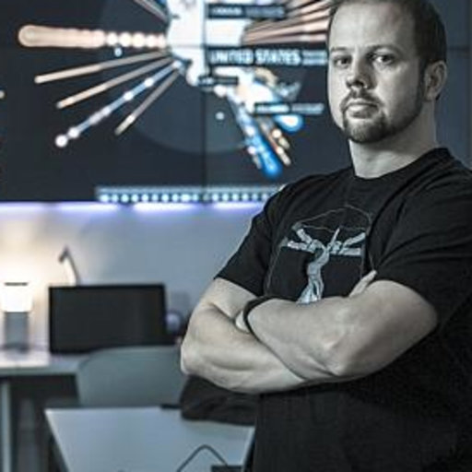
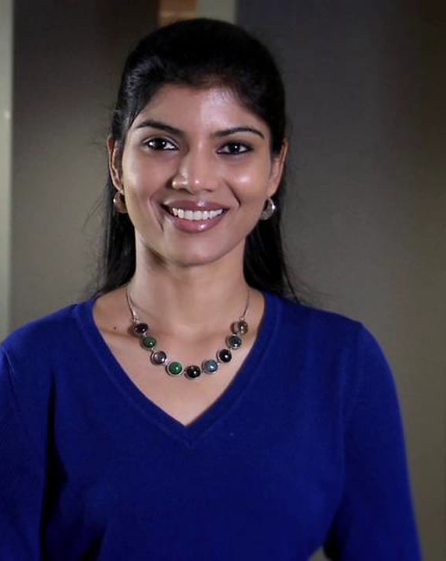
Clients
Jim Cook
Viji Venkataramani

Slide 4
TechLab Description
URL: trends.techlab.works
Web platform for sharing tech trends and projects by TechLab
Targeted at students, staff, educators, researchers and external partners
TechLab aims to provide a source of information for research projects.

Slide 5
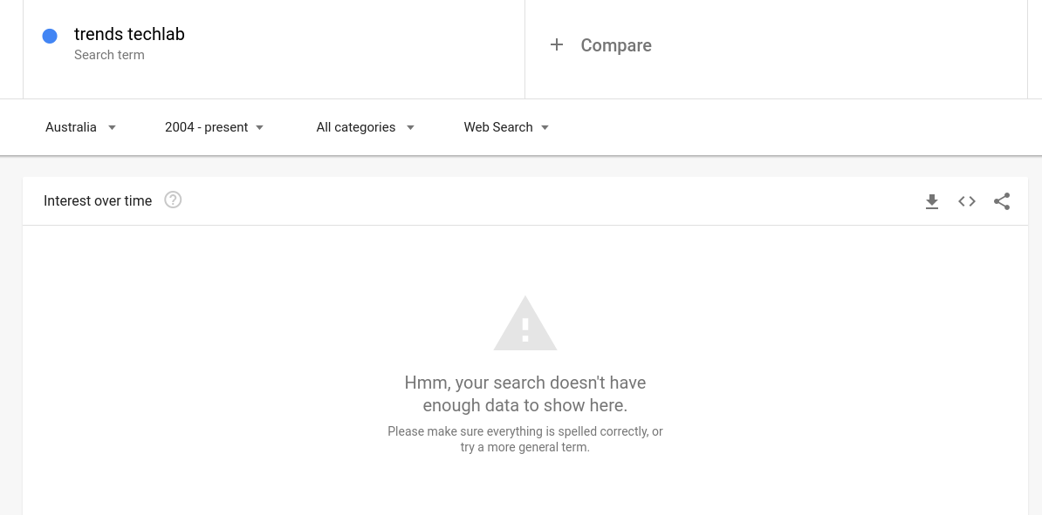

Slide 6
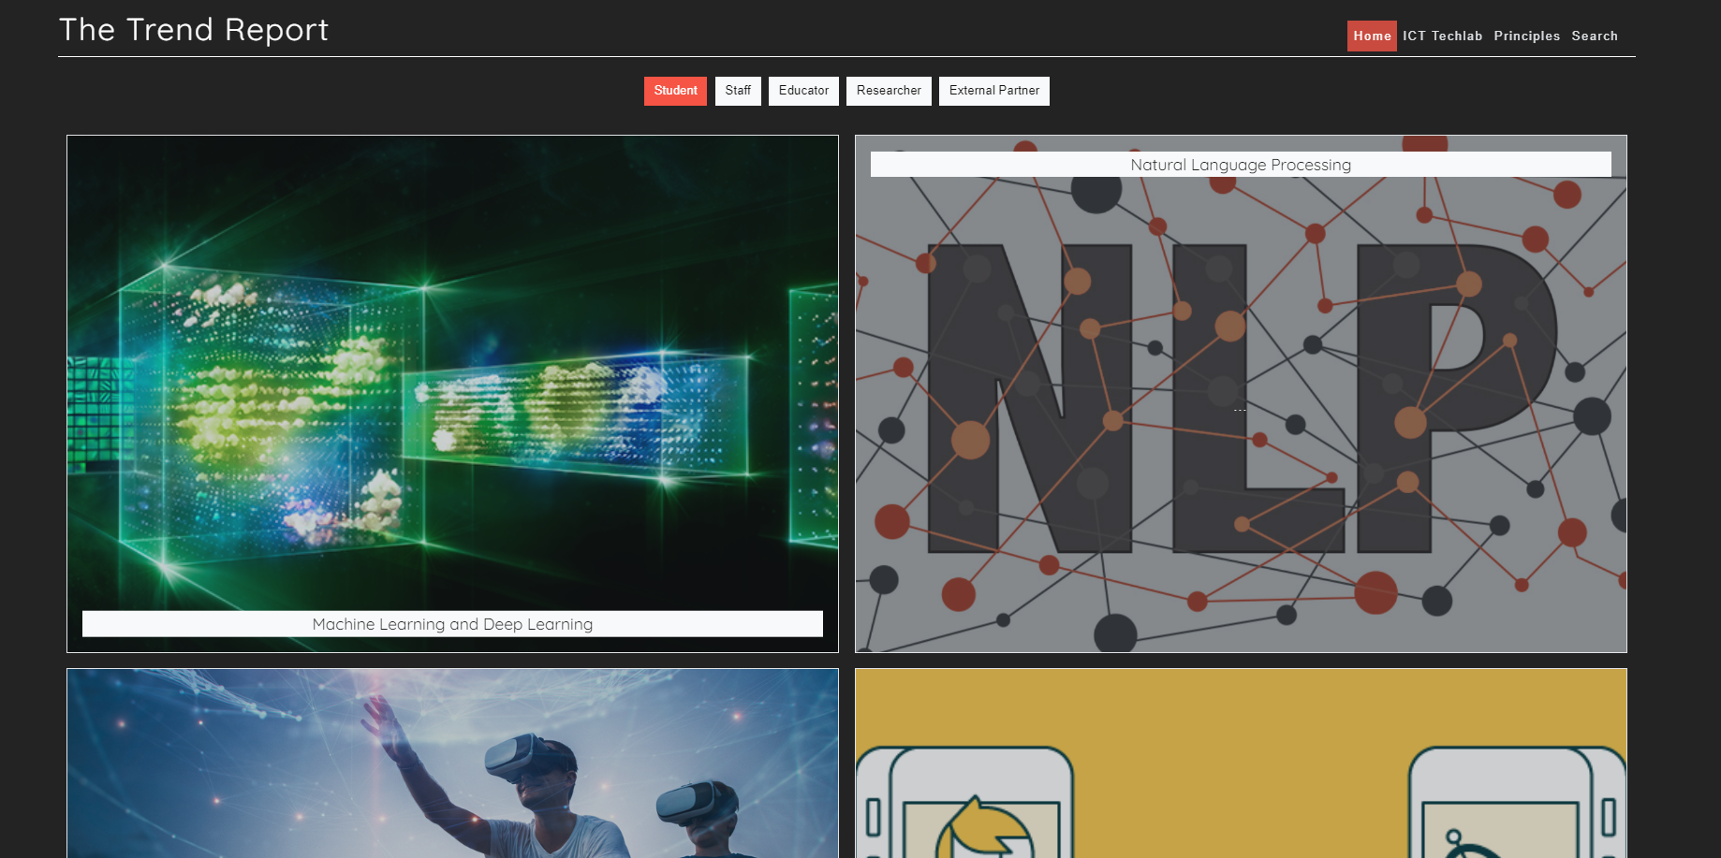
TechLab Trends HomePage

Slide 7
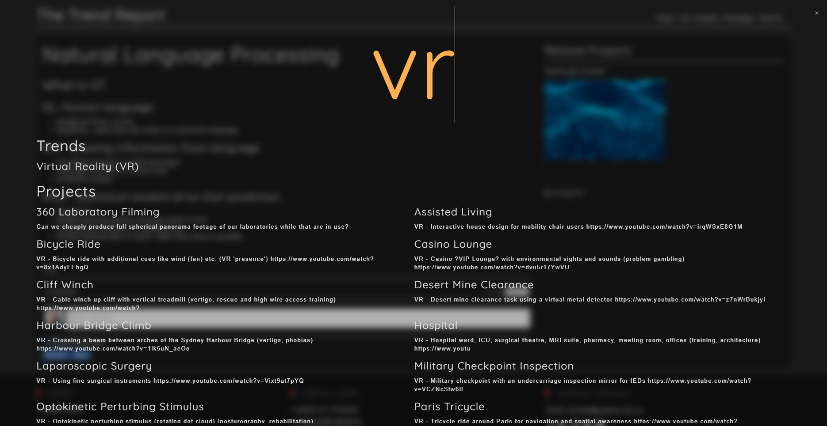
Old Website Walkthrough - Search

Slide 8
TechLab Previous Issues
Need for a redesigned UI/UX for easier and more engaging browsing.
Basic search capabilities, only shows trends and related projects
No navigation between articles back to home page
Lacks tagging system

Slide 9
Requirements
Notes:
How we prioritised user stories - high priority level for the ones that the client’s requested or showed strong interest. Lower for the ones that we brought it up ourselves to implement

Slide 10
TechLab Trends - Requirements
Choosing the ‘type of user’ will filter articles on the home page and allow admins to monitor type of engagement
A need for more a sophisticated search for a more tailored user experience.
Improved monitoring of site engagement

Slide 11
TechLab Requirements
Social Media links on article pages
Events side panel informing users of upcoming TechLab events.
Markdown editing for articles with the ability to embed videos

Slide 12
Overview
User Story (Reader) | Priority | Risk | Functional | Non-Functional
As a user I'd like to be able to see icons in the header representing the social media presence of the Techlab so I can navigate and view their pages | High | Low | Users should be able to navigate to social media pages through the icons | The web report should have increased usability to display further information via other media
As a user I would like to see a footer and header to display links to content of the website in order to easily navigate to parts of the website | High | Low | Users should be able to easily navigate through the website and avoid possible dead ends | The website provides higher recoverability for the users to navigate back to other parts of website upon their will
As a user I want to have a "contact us" form so that I can directly get into contact with the admins of the website. | High | Low | Users should be able to communicate with the admins through a form submission | The website may increase effectiveness in communicating with the admins as these forms are easily available on the web report
As a user I want to see an about page in order to get know more about the creators and admins of the TechLab website | High | Low | Users are able to access "about us" page in order to intake more information on the admins | The web report supports higher accessibility of certain information through buttons and navigation bars

Slide 13
User (admin) stories
Hi
gh
Low
As an author, I would like to easily add new admins onto the list so that I can easily give specific permissions.
As an admin, I would like to expand on articles about trends by providing sections for Trends -> Projects -> Experiments -> Codebase, so that I can easily add more information about a trend.
As an admin, I would like a way to capture user interaction so that I can capture and analyse the type of engagement with the content.
As an author, I would like to be able to easily change the contents of the reports so that I can easily edit and add changes to the existing posts
As an admin, I would like to be able to easily add tags to an article so that I can easily categorise the content.
As an author, I would like to provide quick navigation to other social networking sites so that the readers can actively communicate with us.
Priority

Slide 14
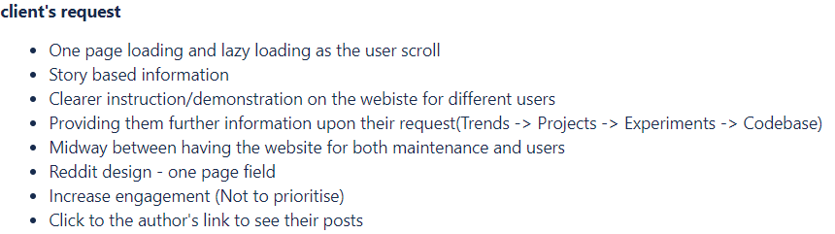
User (Reader) stories with top-priority
As a reader, I would like to expand information specifically related to my role as a student/tutor/academic researcher so that I can see information only relevant to me.
Client requested feature (Point3 & 4)
Expected sprint 4-5 days
Acceptance criteria set by checking with the clients and being able to categorise information on different levels.
Ensure progress with client through weekly meetings
Functional requirement: Readers should be able to select level of information they want to read and expand on more information upon their request
Non-functional requirement: The website should display enhanced accessibility of organised content to the readers of different roles.
Notes:
Client requested feature as it can be seen in the picture. They reaslied the problem that jargons wouldn’t really help people like students or people with no acadmeic background
Expected sprint without having to write all the contents

Slide 15
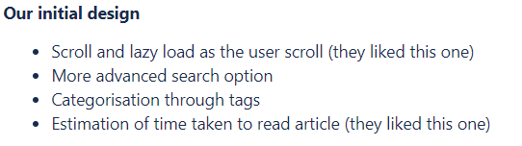
User (Reader) stories with top-priority
As a reader, I would like to look through categories and tags so that I can find all related articles at once.
Our initial design that the client showed interest
Expected sprint 9-10 days to upgrade existing search bar which has no advanced function and tags.
Acceptance criteria set by the clients through meetings.
Ensure progress with client through weekly meetings and look for any need for changes.
Functional requirement: Readers are able to navigate to chosen topics via reader selected categories or tags.
Non-functional requirement: Categories and tags should help the users to browse through the TechLab report with increased efficiency compared to original version.

Slide 16
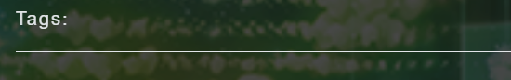
User (Admin) stories with tests
As an admin, I would like to be able to easily add tags to an article so that I can easily categorise the content.
Current tags contain nothing but client showed interest in using them.
Estimated to take 2-3 days to generate tagging system.
Acceptance criteria would include correct navigation, use and display of tags in the article but also by clients..
Ensure progress with client through weekly meetings and look for any need for changes..
Functional requirement: Admins should be able to easily add or edit tags through edit tag or add tag function.
Non-functional requirement: If implemented, it should increase the quality of maintainability of the articles and reports for the admins as it supports organisation of articles based on categories for the admins.

Slide 17
Wix Mock Design
https://linv428.wixsite.com/website

Slide 18
Final Product
Notes:
How we prioritised user stories - high priority level for the ones that the client’s requested or showed strong interest. Lower for the ones that we brought it up ourselves to implement

Slide 19
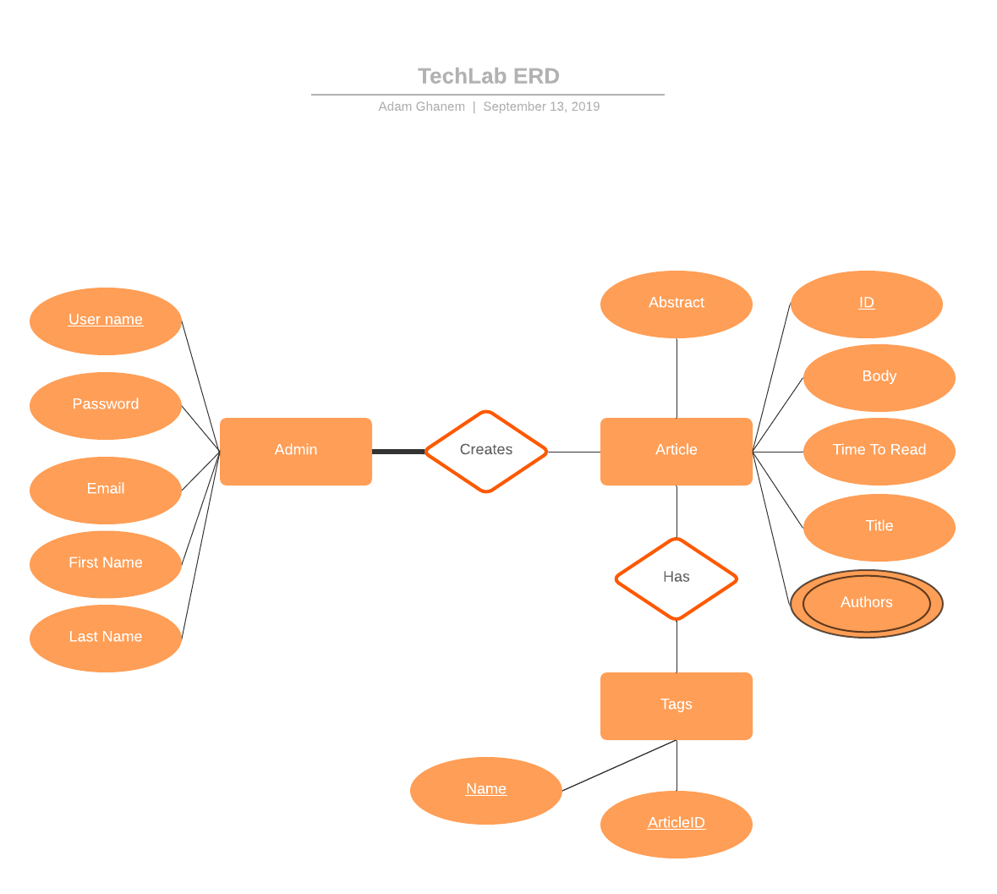
System Structure

Slide 20
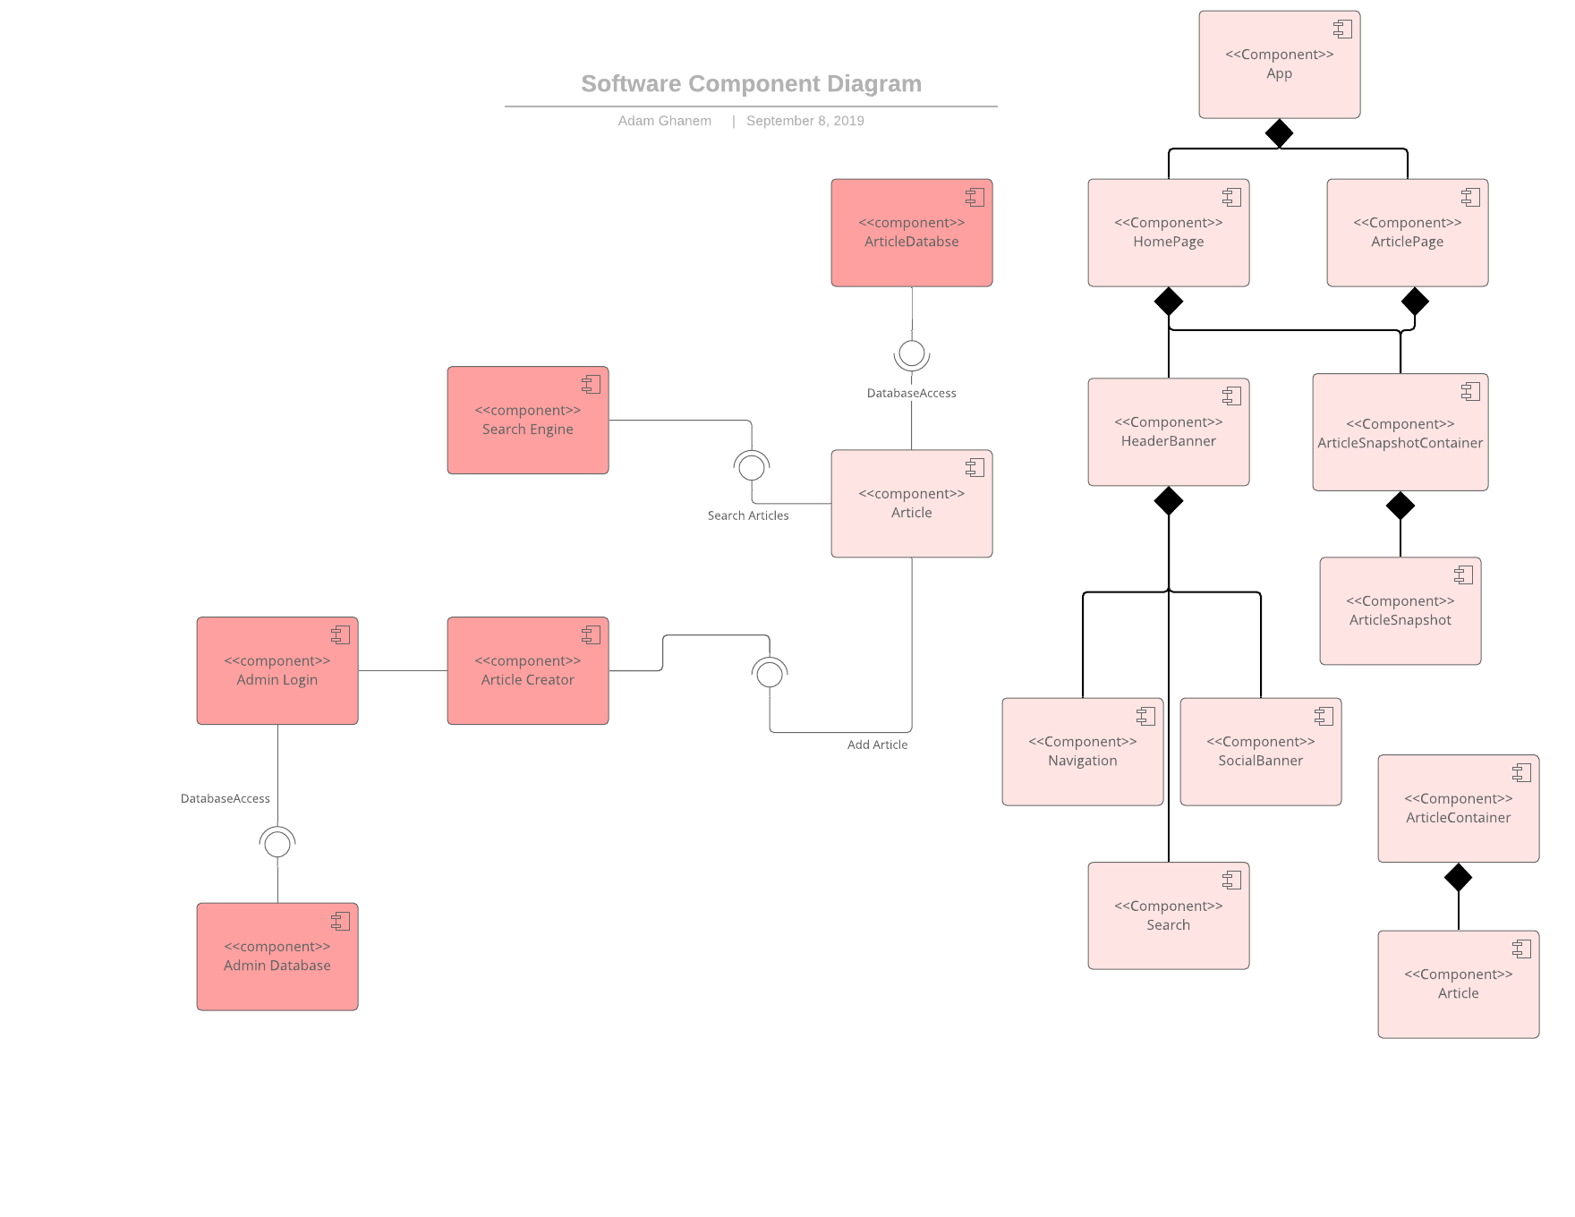

Slide 21
Final Product
Notes:
How we prioritised user stories - high priority level for the ones that the client’s requested or showed strong interest. Lower for the ones that we brought it up ourselves to implement

Slide 22
Stretch Goals
As a user, I would like to be notified of upcoming events and view all upcoming events
As an author, I would like to be able to notify users of upcoming events related to TechLab
As a user, I want to be able to have a storage of my last viewed, favourited and ‘read later’ articles in order to improve viewing experience
As a user I want to have an integrated chatbox so that I can be able to communicate with support quickly and determine a field I am interested in..
As a user I would like to have a modal design when browsing through articles, this way it allows me to easily navigate around the website.

Slide 23
Quality Assurance
Notes:
How we prioritised user stories - high priority level for the ones that the client’s requested or showed strong interest. Lower for the ones that we brought it up ourselves to implement

Slide 24
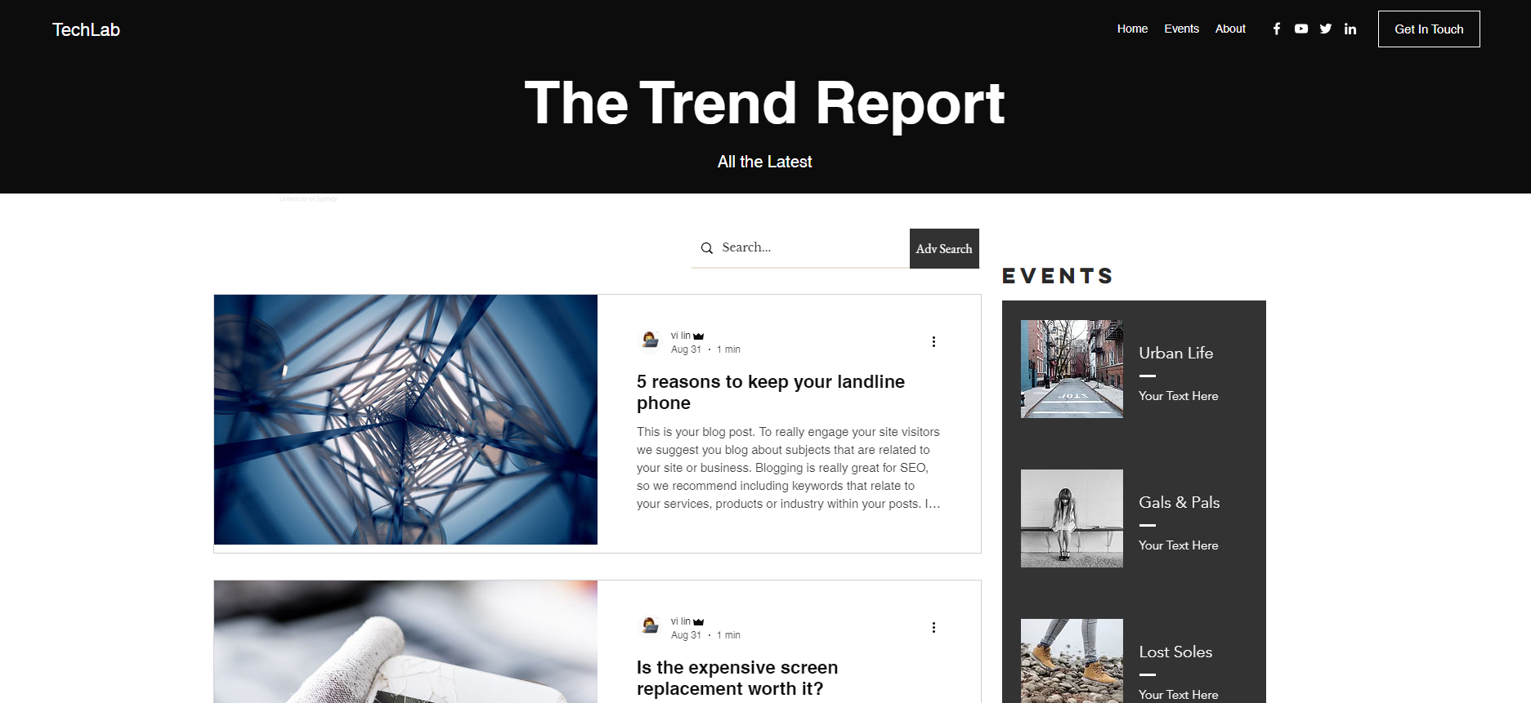
User story 0
As a reader, I would like to browse through the website without being overwhelmed so that I can browse for longer with comfort
Acceptance test / review from a UI professional John El Khoury.
UI professional John confirms that the design match the agreed upon prototype and gives suggestions for changes
John reviews the design and confirms the usability of the design and implementation.
Web Content Accessibility Guidelines (WCAG) 2.1 Guideline for designing websites to be more accomodating for people with disabilities including blindness and limited movement

Slide 25
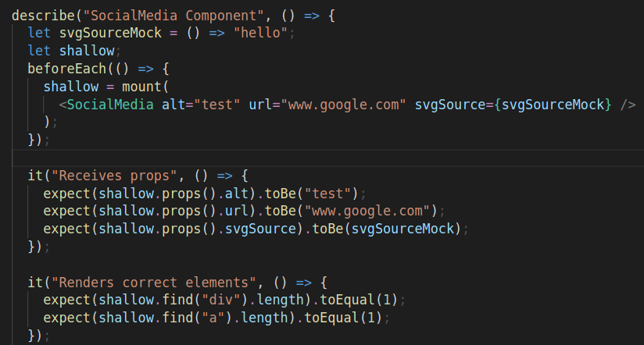

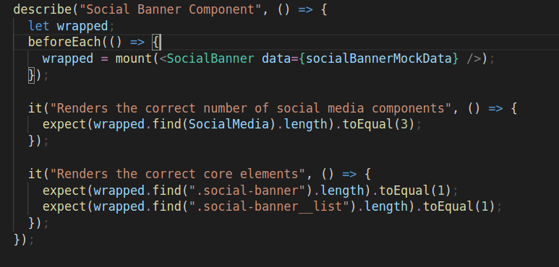

User story 1
As a user I'd like to be able to see icons in the header representing the social media presence of the Techlab so I can navigate and view their pages
Component:
Acceptance Test: Normal: User clicks on each icon and is redirected to the correct links for Facebook, Twitter, Youtube channel and Githubs Boundary: User clicks on all corners of the image and is redirected User can access these links when scrolled …………………. down on the page Abnormal: The user can use TAB to navigate to these buttons and select using ENTER, opening links into a new tab
Test SocialBanner component receives correct props and renders correct elements

Slide 26

User story 2
As a user I would like to see a footer and header to display links to content of the website in order to easily navigate to parts of the website
Header & Footer
Normal: All links redirect to the correct page or act as an anchor to a specific part of a page from Footer and Header. H
Boundary: Header remains fixed on top of the page, anywhere the user scrolls. All links open properly at any position. Abnormal: User can use keyboard controls to open the links to another page or drag to a new tab.

Slide 27
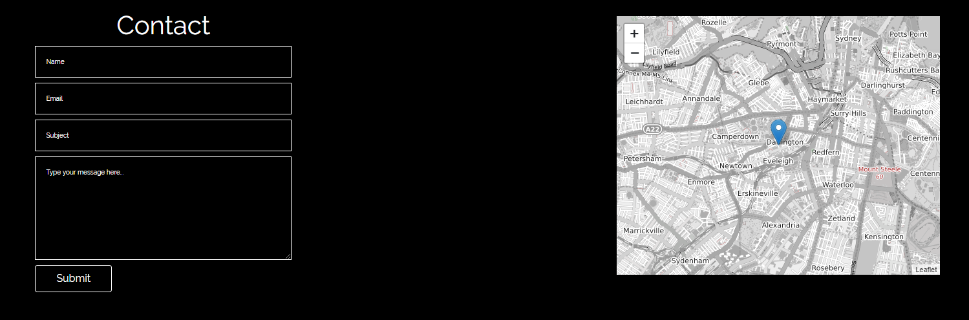
User story 3
As a user I want to have a "contact us" form so that I can directly get into contact with the admins of the website.
Acceptance test Normal: User clicks on “Get in touch” or “Contact us” from the header or footer, and is either anchored to the contact form on the page using a fade and scroll animation or new url. Map is also shown for physical contact.
User can type into the form and receive confirmation that the message has been sent.
Boundary: Links work on every page
Abnormal: User does not fill in the form correctly and receives error message to try again

Slide 28
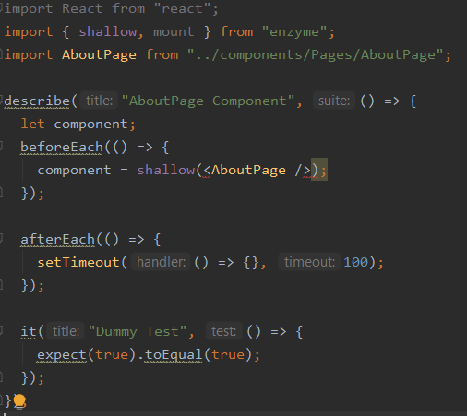
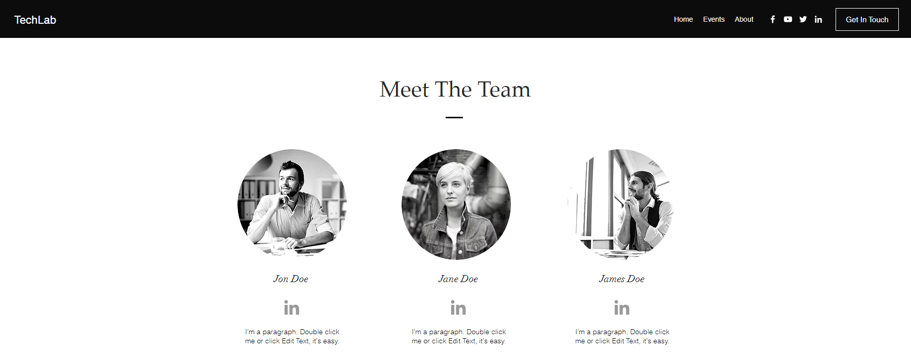
User story 4
As a user I want to see an about page in order to get know more about the creators and admins of the TechLab website
Unit test to test About Page rendering
Normal: User clicks on “About” or “Meet Us” links in the header/footer and is directed to an about page Boundary: User types in URL address ending with “/about” and is redirected to the about page Abnormal: User types in the wrong address and is redirected to 404 page

Slide 29



System
Architecture

Slide 30
Front-end - Tools & Frameworks
React:
Javascript framework/library
Chosen for its compositional nature (high reusability)
High capability (safety net if client expands requirements)
Fast development compared to vanilla JS
HTML/CSS:
As standard
Sass:
CSS preprocessor
Improves maintainability and structure of CSS (7-1 architecture)

Slide 31
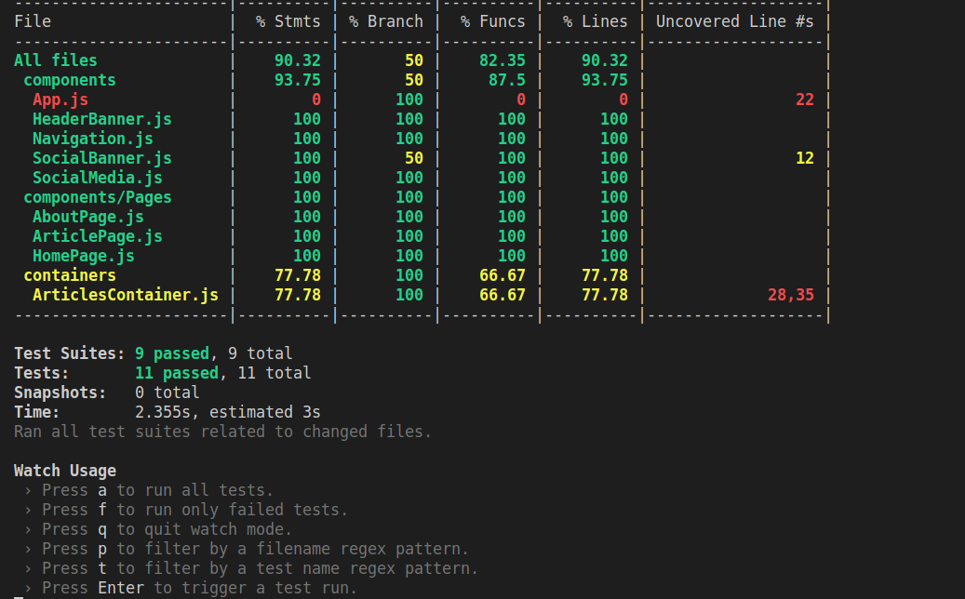
Jest:
Javascript unit and integration testing
Chosen because it includes testing, coverage reporting and mocking
Familiar with it so no learning time required
Enzyme:
Testing library build by airbnb for testing React components
Used to mount components on a virtual DOM for interaction/assertion
Cypress.io:
E2E testing library
Can traverse a website simulating events
Will be used for total system tests ensuring front
and back end communicating correctly

Slide 32
Front-end - Test Examples
Story #1: As a reader I want to search for articles so I can find related articles that I'm interested in
Test plan:
System test: Cypress will be used. It will trigger a search and assert at least one article has been returned and rendered by the search by looking for the component's data-componentType attribute
An enzyme test will be written with a mounted <SearchResultsContainer /> component which will make an API call to a mocked endpoint. We will assert the <SearchResultsContainer /> renders the correct SearchResult components (based on the mock)
Story #2 : As a reader I would like to look through categories and tags so I can find all related articles at once
System test: Cypress - trigger a search with a specific tag set, assertion iterates over each search result ensuring all have the matching tag rendered in the DOM

Slide 33
Backend
Notes:
How we prioritised user stories - high priority level for the ones that the client’s requested or showed strong interest. Lower for the ones that we brought it up ourselves to implement

Slide 34
Back-end - Tools & Frameworks
Python3.5/Django
MVC web framework
Thoroughly featured for complex web development
Built-in database features
Built-in user system
Administration tools
Industry standard security implementations
Used in large-scale industry applications
Social media: Instagram, Spotify, Youtube
Cloud services: Dropbox, Bitbucket
Framework used in existing implementation
Does not require environment changes to server

Slide 35
Back-end - Tools & Frameworks
MySQL Databases
Reliable, secure DBMS, used commonly in industry applications
Military/Government applications: US navy, NASA
Social media/News: Tumblr, Twitter, BBC News
Django support for MySQL 5.6+
DBMS used in existing implementation

Slide 36
Django - RESTful API framework
Web framework for Python 3.5
Used for the original Techlab Trends codebase
Front-end: Integrates ReactJS to serve practical interfaces
Back-end: Integrates MySQL using Connectors to fulfill database-related requirements.

Slide 37
Back-end Testing
Purpose of system back-end is to resolve API calls
Unit testing: Standard Python unittest module for Django
API reference to be used as foundation of testing I/O, e.g. For valid input “GET /article/[id]”, Expect JSON object: { success: true, article: { title: [article id title], content: title: [article id content], image: title: [article id header image], author: [article id author], tags: [tags associated with article id] } };
Security testing
Common SQL injection vectors
Cross-site vulnerabilities (XSS/CSRF)
Stress testing for availability under high load

Slide 38
Group Collaboration and processes

Slide 39
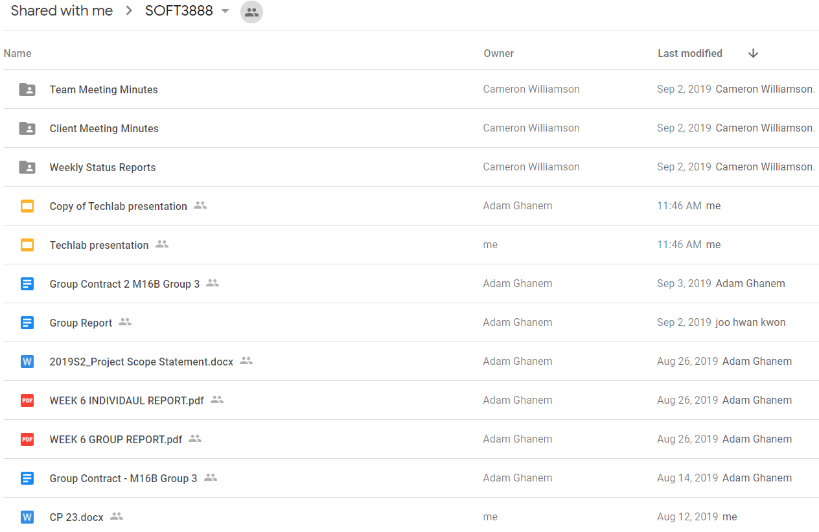

Collaboration over documents
Notes:
Evidence of collaboration - meeting minutes and report works.
Originally started on google drive as not everyone was familiar with bitbucket wiki however, as everyone got used to it, we started working directly on wiki

Slide 40

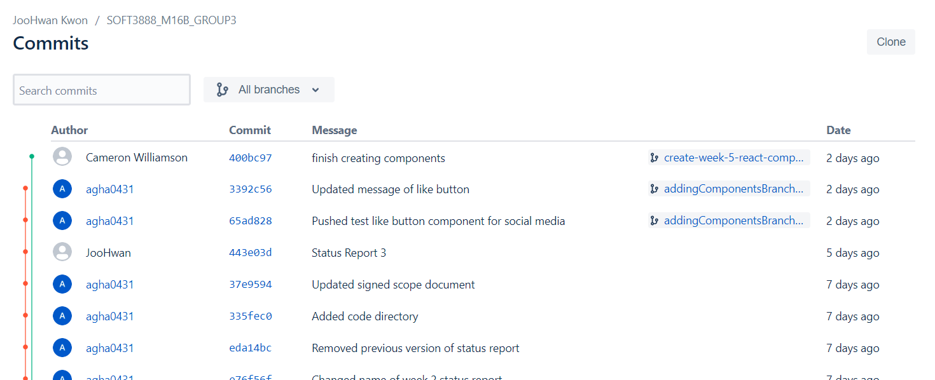
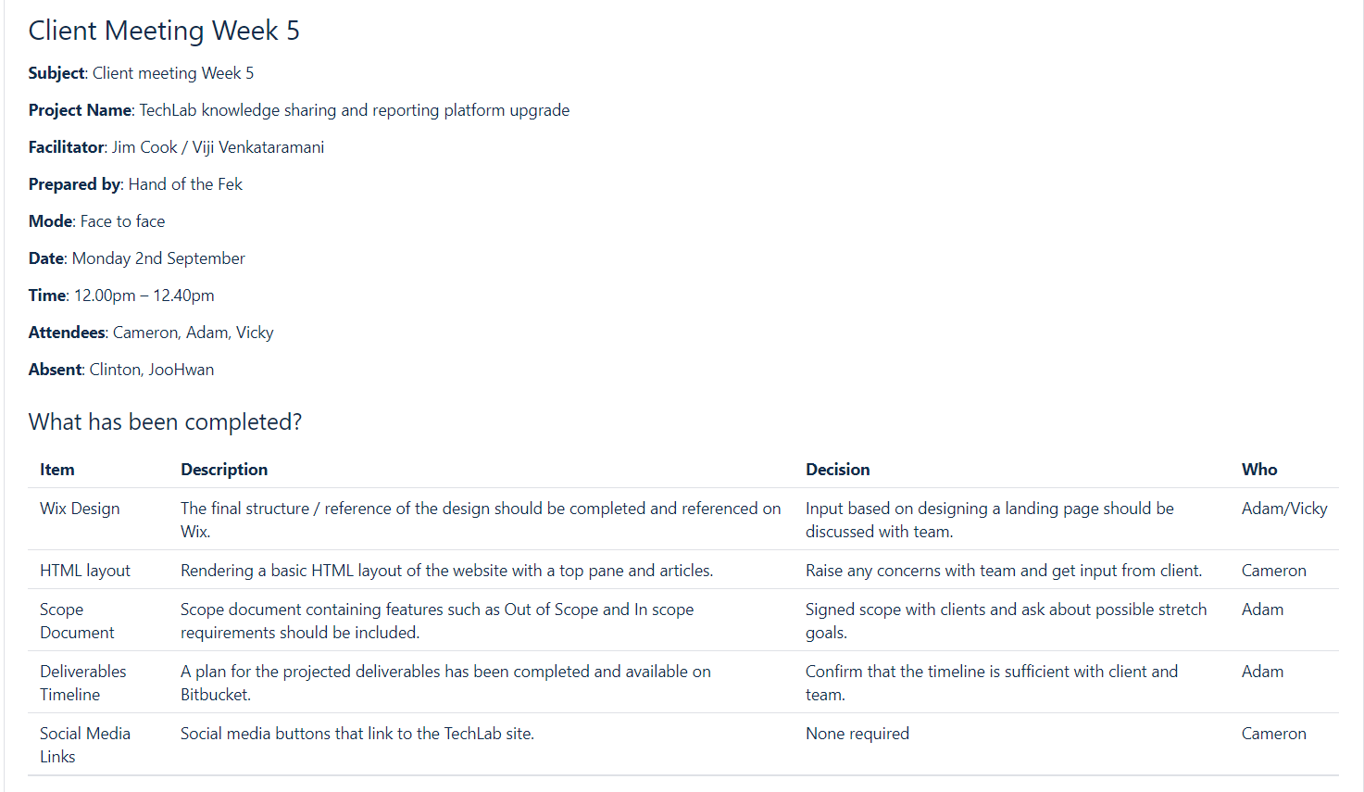
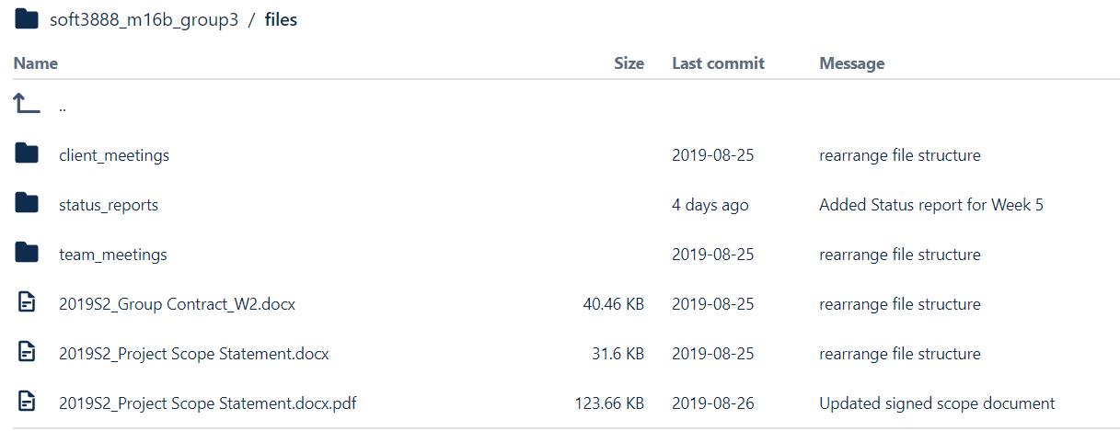
Bitbucket - Git repository for codebase & files
Notes:
Evidence of collaboration
Use of bitbucket and slack and other unfamiliar tools
Bitbucekt for programming collaboration and wiki for document collaboration

Slide 41
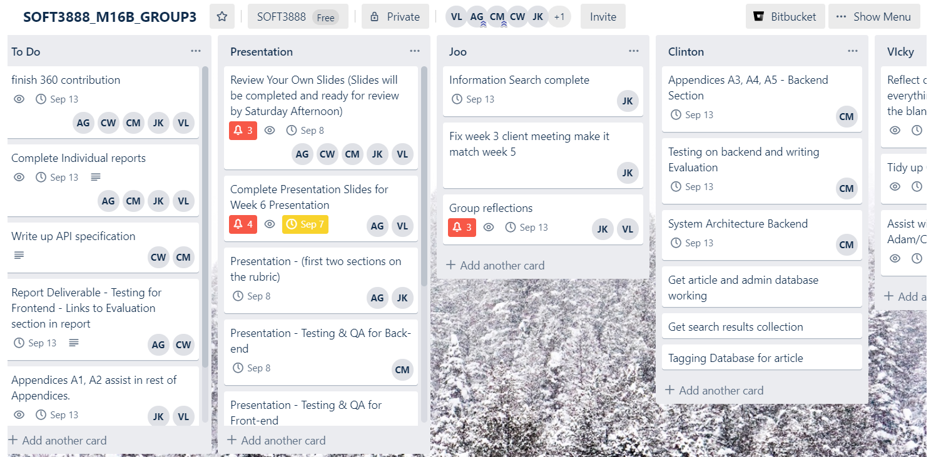

Trello Board
Notes:
Trello used for division/allocation of tasks and each task’s schedule.

Slide 42
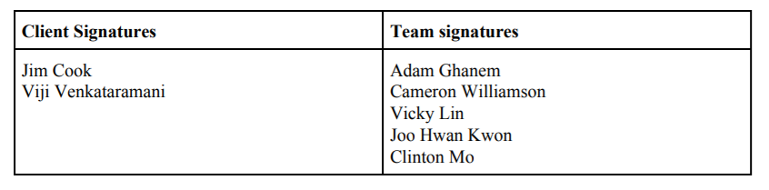
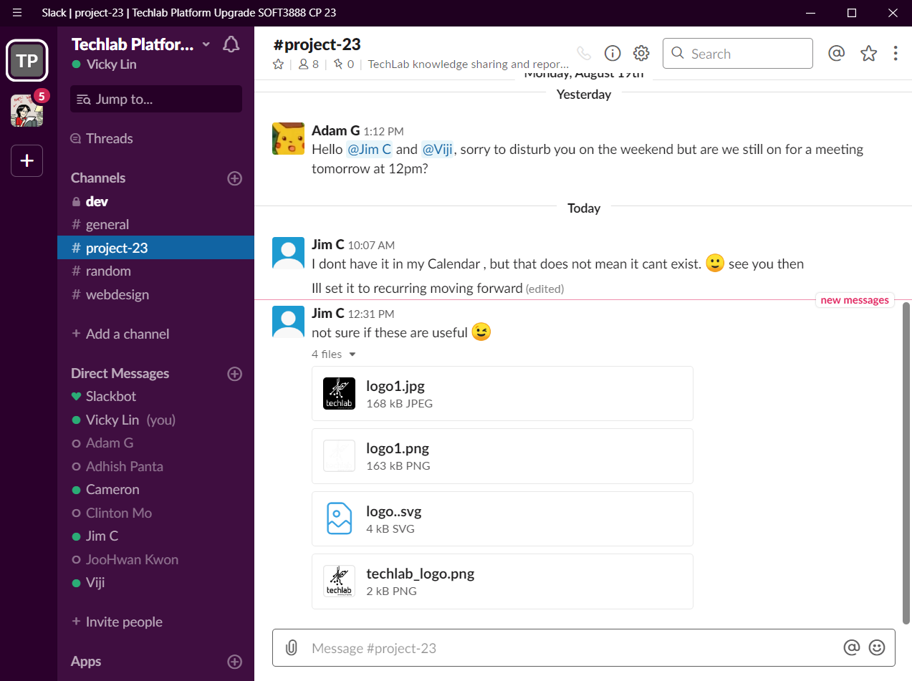
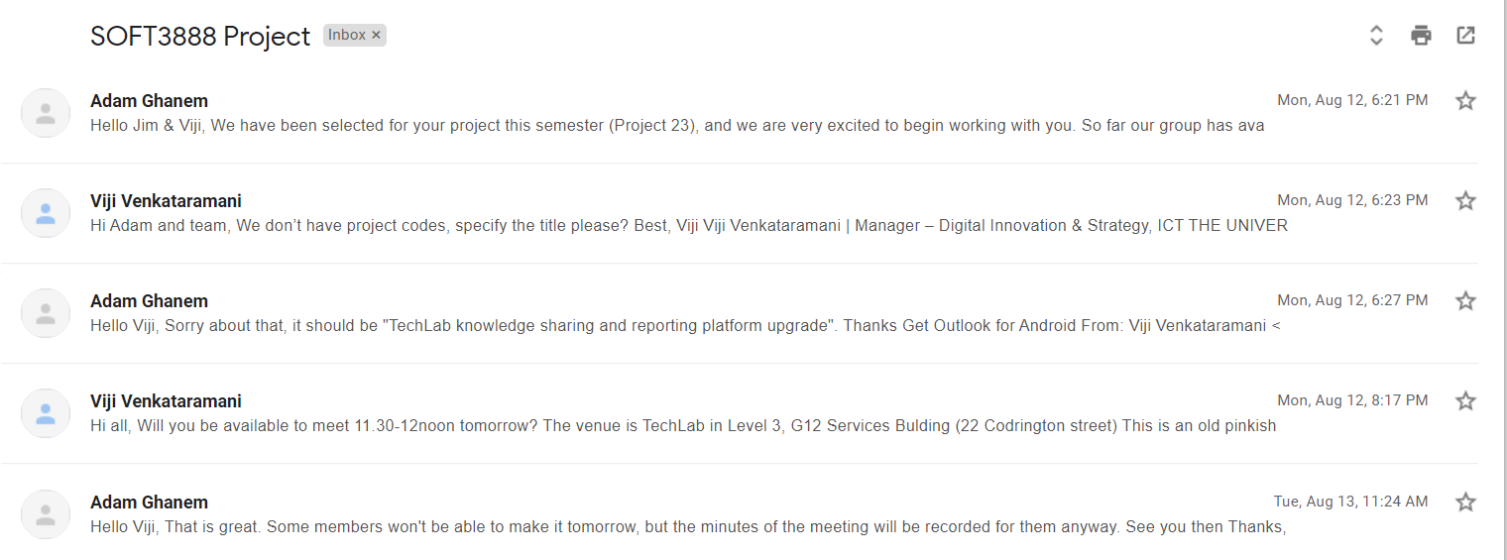

Slack - Client
interaction
Scope Statement signatures
Email correspondence with clients
Notes:
Work with clients - use of slack, scope statement signatures, email - Main source of communication between client was face to face (weekly client meetings) but also used Slack to resolve simple problems and ensure with clients.

Slide 43
XP
XP Role | Members
Tracker | Adam
Manager | Adam
Customer | JooHwan
Programmer | Clinton
Tester | Vicky
Doomsayer | Cameron
Directly Responsible Individuals (DRI)
Promotes taking ownership for tasks and therefore holding members accountable
Alleviates strain on manager
Group Roles
Git Expert - Cameron Slack Expert - Clinton BitBucket Expert - Adam XP Expert - JooHwan, Vicky
Notes:
FIrst dot point - evidence of team work - group roles
These were the main XP roles assigned to individuals for the whole semester based on their strength.
Reason for main XP role was to ensure quality of weekly tasks by weekly xp roles and to provide guidance if needed to each individuals.

Slide 44
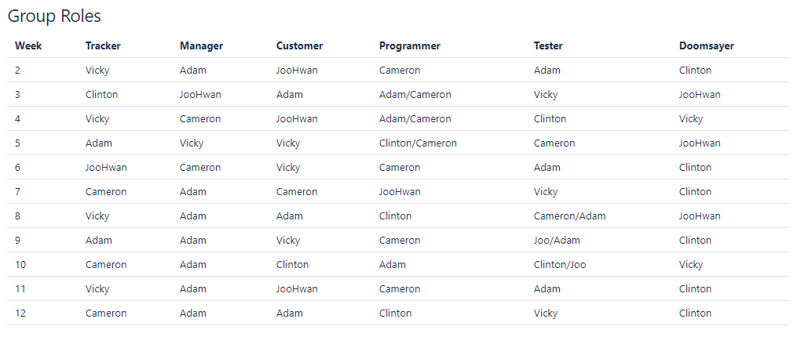
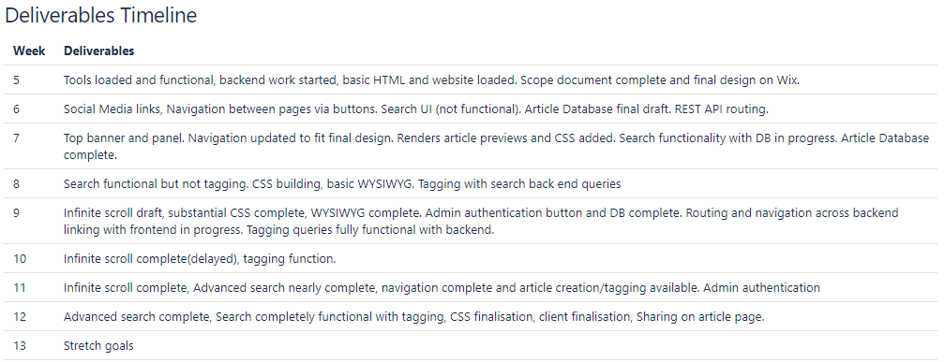
Weekly roles and deliverables
Notes:
Follow a systematic process of work - weekly plan and task allocation
Further weekly task allocation through weekly roles (Each individuals had 2 roles each week, one main role and one weekly role)

Slide 45
Issues
Issues
Some members lacked knowledge and experience in web development.
Having no apparent limitation in terms of structure, design and implementation. (Scope/project creep)
Missing data and components from original platform
Progress
Members consistently spent time learning web development and those with experience supported others.
Set up clear distinction between prioritised user stories and stretch goals.
Created dummy data and interface for admins to better manage components.
Notes:
Issues/challenges faced as team vs progress we made to resolve issues.

Slide 46
Critique
What has worked well
Members are present at offline meetings and responsive offline - great communication
Use of online tools such as Trello board, Slack to keep track of deliverables and individual progress
Experts made sure the team is aware of all the components used in the project
XP roles assigned each member responsibilities as a group member. E.g. the manager helps run smooth meetings and delegates tasks quickly
What needs improvement
Clearer division of tasks - Although Trello had achieved this, we needed more detailed and distinctive descriptions of tasks
Decomposition of tasks so that each member was directly responsible for more specific work packages.
Individuals to spend more quality time earlier stage to gain required knowledge. E.g. Django, React.js.

Slide 47
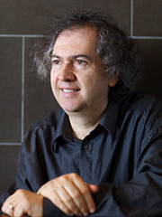
Thank you

